Slide 1

Polymers
Dr. J. Venkatramani
219-B
venkatramani@iiitdm.ac.in

Slide 2
Polymers
Naturally occurring polymers – wood, rubber, cotton, wool, leather and silk, proteins, enzymes, starches and cellulose.
Synthetic polymers

Slide 3
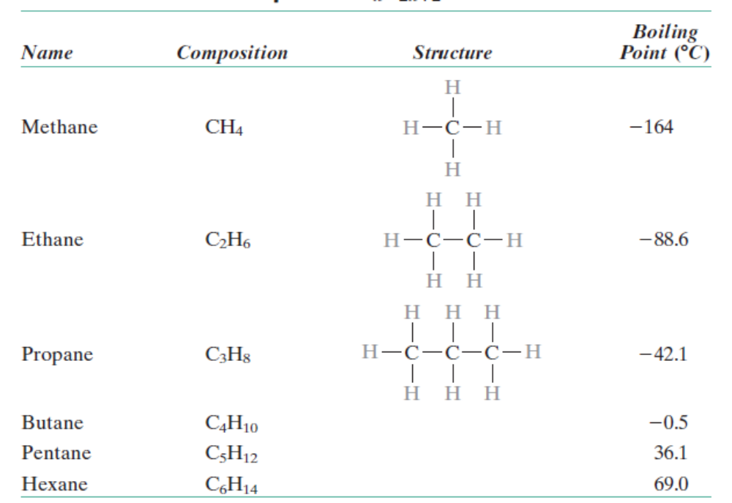
Hydrocarbons
Many organic materials are hydrocarbons – hydrogen and carbon.

Slide 4
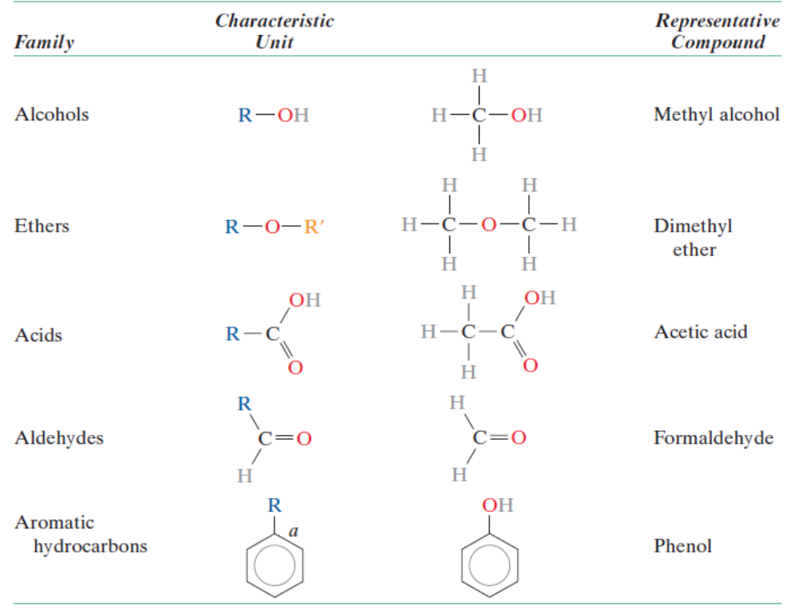
Polymer molecules – macromolecules
Replication of repeat units. Not to be confused with monomers.

Slide 5

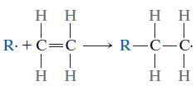
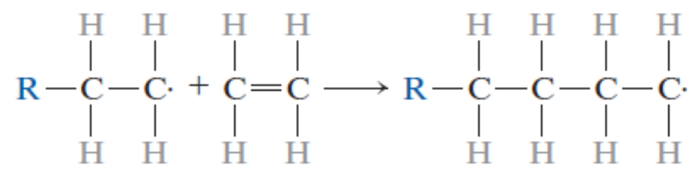
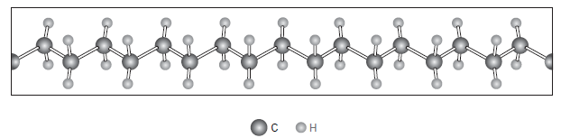

Polymer molecules – Chemistry
Polyethylene, a solid material from ethylene, which is gaseous state under room temperature and pressure.
Repeat Unit

Slide 6
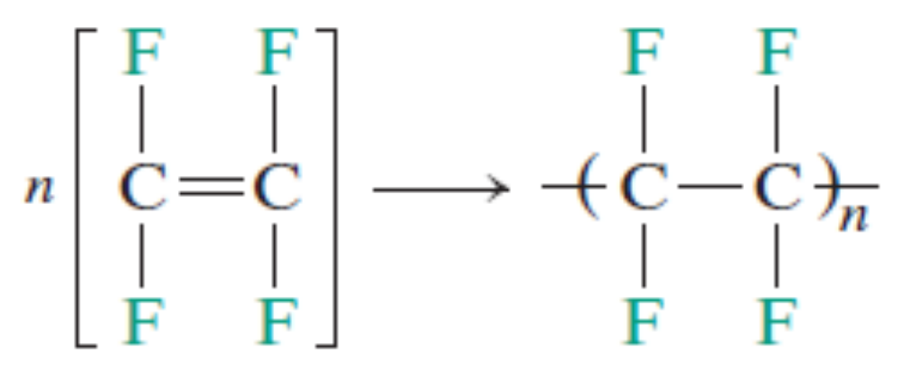
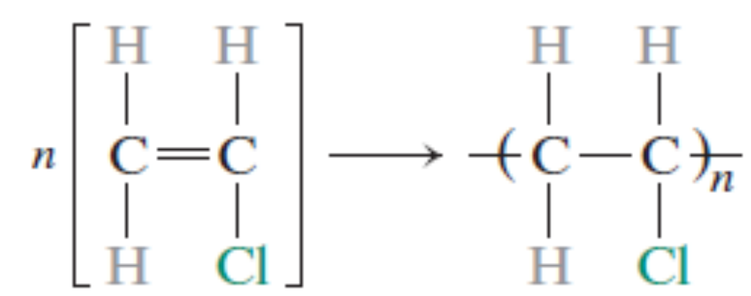
Polymer molecules – Chemistry
Polytetrafluroethylene (PTFE) a fluorocarbon, is hydrophobic.
Polyvinylchloride (PVC)

Slide 7



Polymer molecules – Chemistry
When all the repeating units are same, polymers are called homopolymers.
Two or more repeat units result in formation of copolymers. Block, Alternating and Random copolymers are the types within this category.

Slide 8
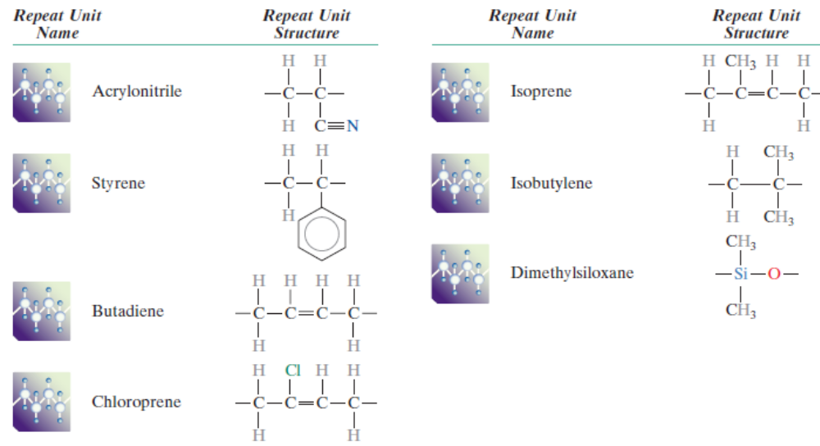
Polymer molecules – Chemistry
Repeat units for various copolymer rubbers

Slide 9
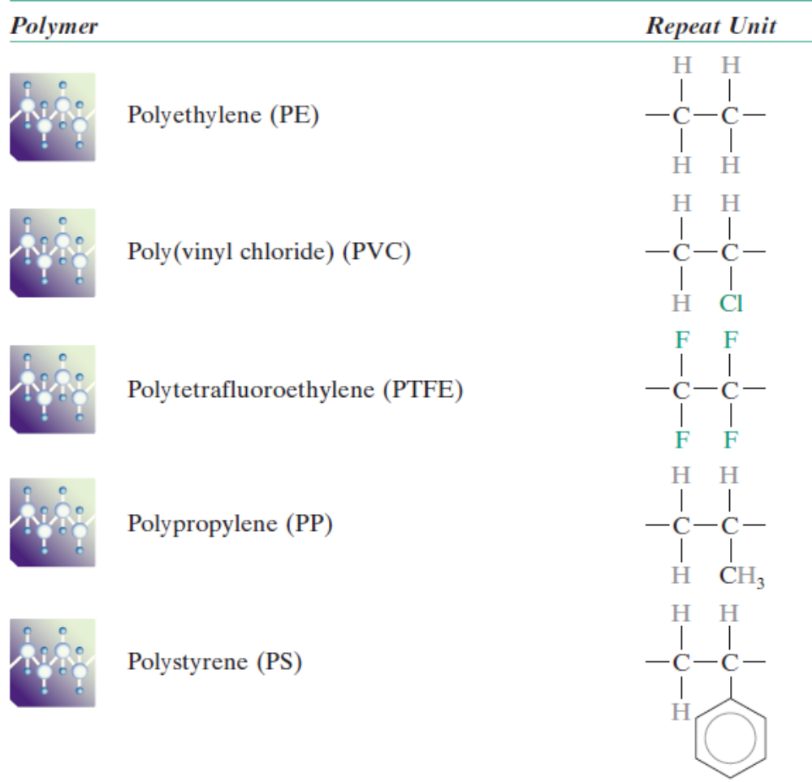
Polymer molecules – Chemistry

Slide 10
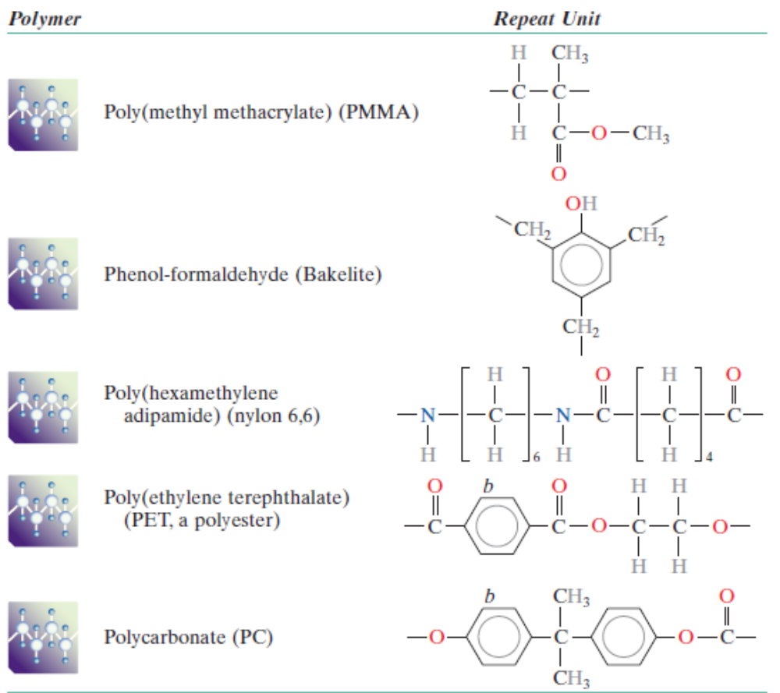
Polymer molecules – Chemistry

Slide 11
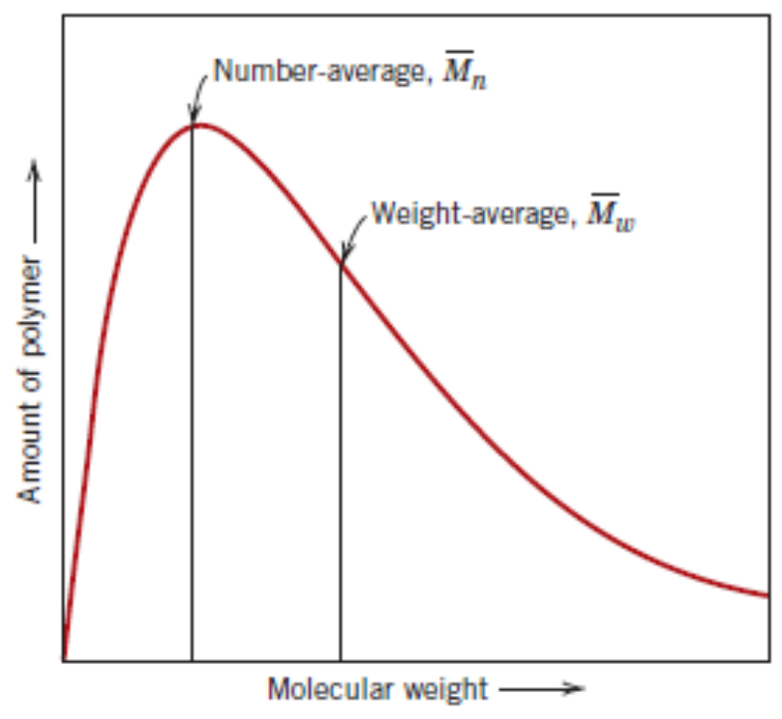
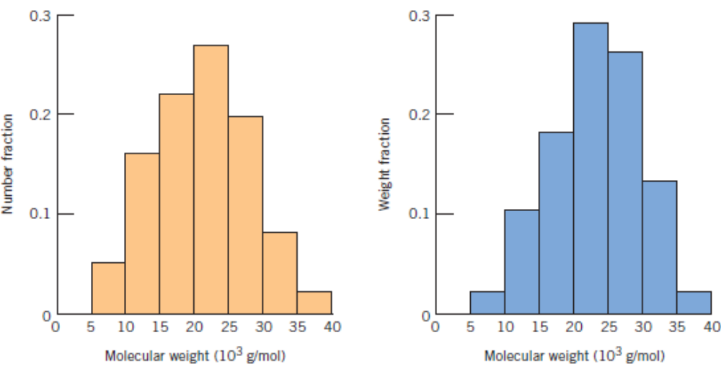
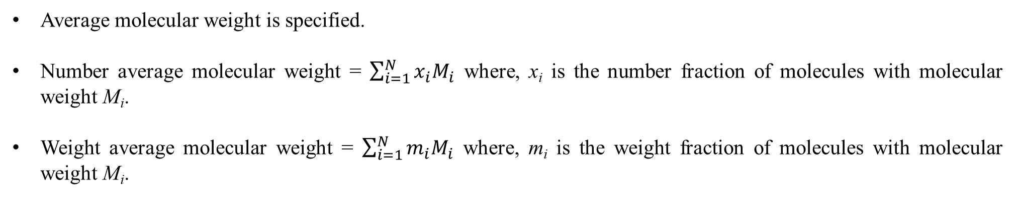
Concept of Molecular Weight of Polymers
Average molecular weight is specified.
Number average molecular weight = $\sum_{i=1}^{N}{x_{i}M_{i}}$ where, x_{i} is the number fraction of molecules with molecular weight M_{i}.
Weight average molecular weight = $\sum_{i=1}^{N}{m_{i}M_{i}}$ where, m_{i} is the weight fraction of molecules with molecular weight M_{i}.

Slide 12
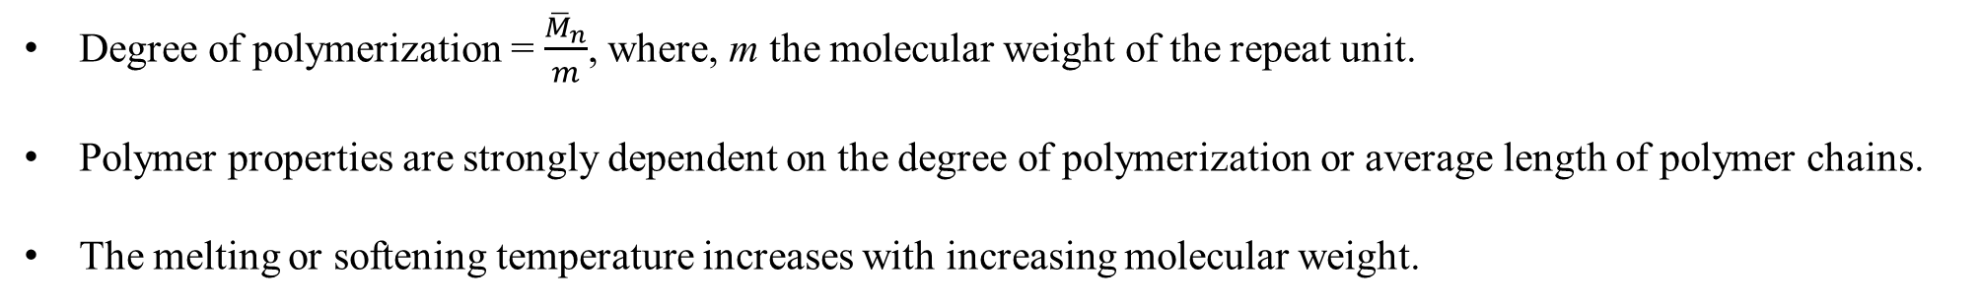
Concepts of Molecular Weight of Polymers
Degree of polymerization = $\frac{{\overline{M}}_{n}}{m}$, where, m the molecular weight of the repeat unit.
Polymer properties are strongly dependent on the degree of polymerization or average length of polymer chains.
The melting or softening temperature increases with increasing molecular weight.

Slide 13
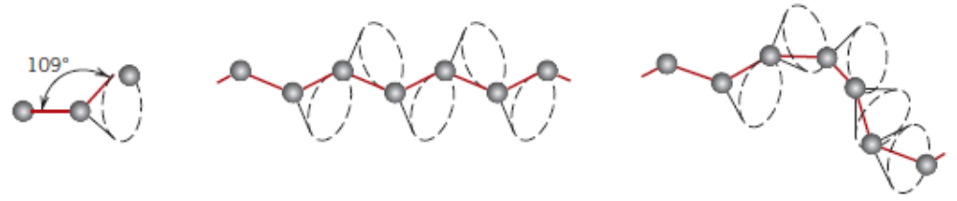
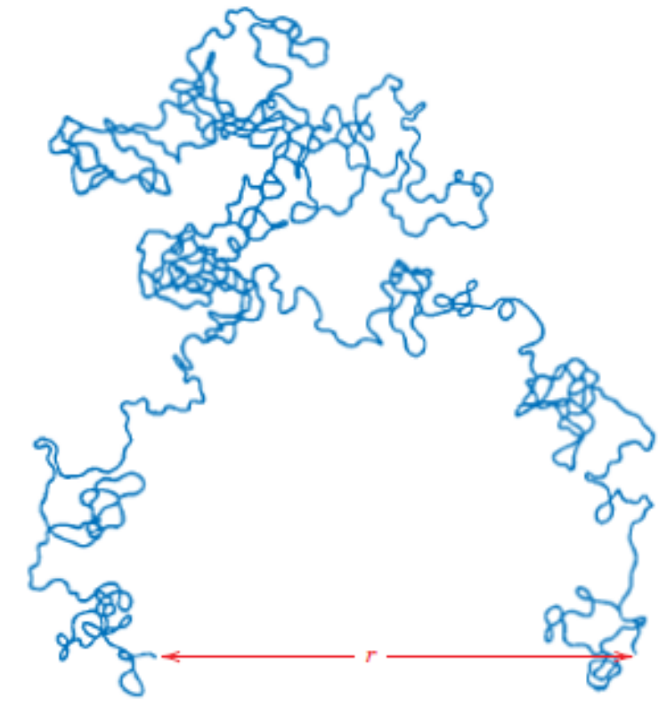
Polymer Shapes, Structures, Configurations
Infinite possibilities of keeping the third atom without violating the angle
Straight chain without any twists or kinks
Twisted Chain
Schematic of the configuration of a long polymer chain

Slide 14
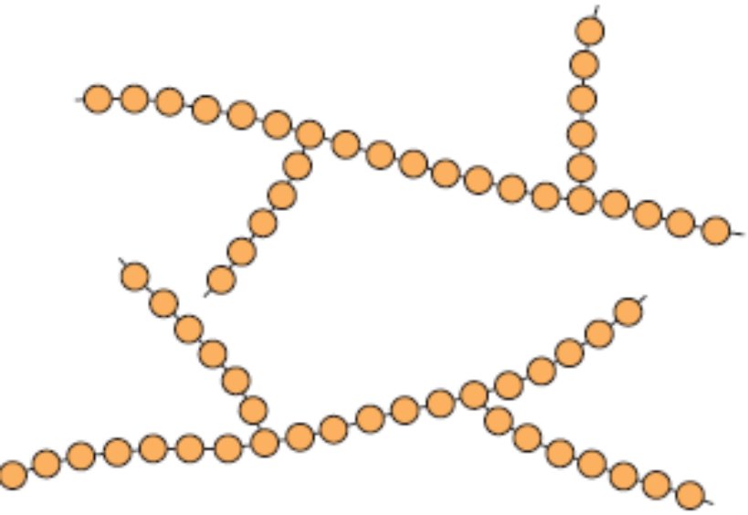
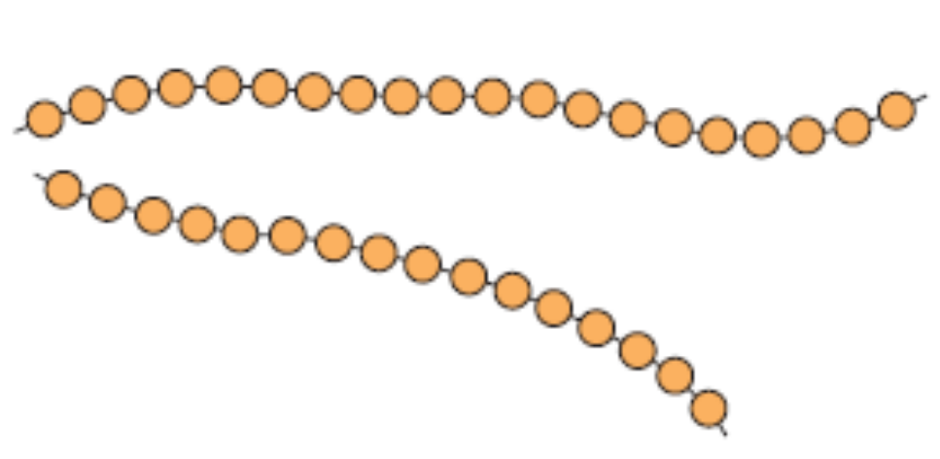
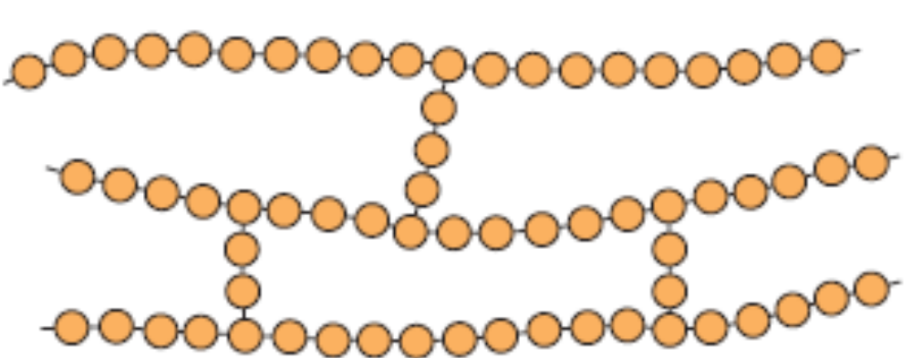
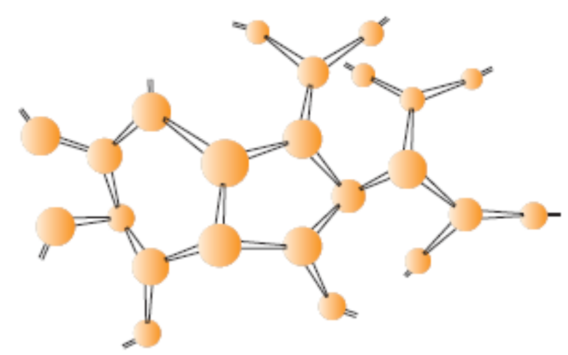
Polymer Shapes, Structures, Configurations
Linear Polymers
Branched Polymers
Cross–linked Polymers
Network Polymers

Slide 15
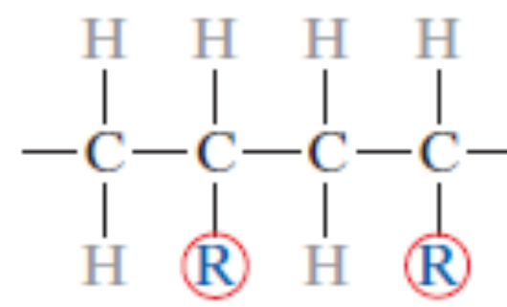
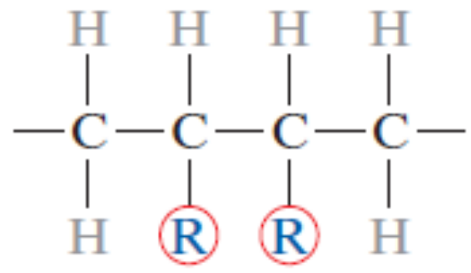
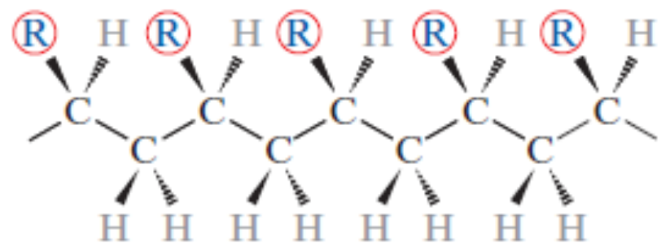
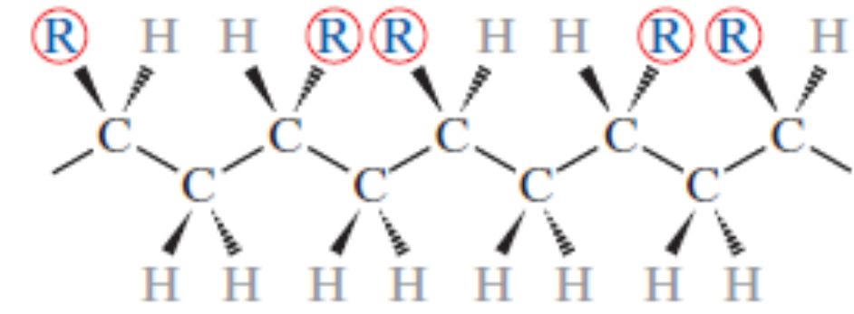
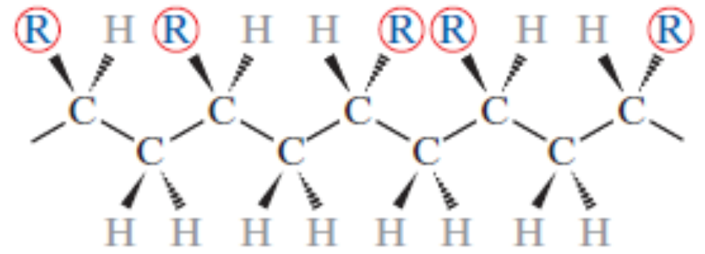
Polymer Shapes, Structures, Configurations
Head to Tail Configuration – more predominant
Head to Head Configuration
Isotactic configuration under Stereoisomerism
Syndiotactic configuration under Stereoisomerism
Atactic configuration under Stereoisomerism– Random Positioning

Slide 16
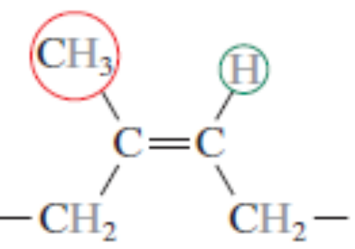
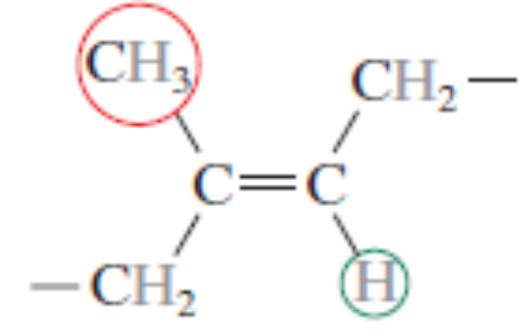
Polymer Shapes, Structures, Configurations
Geometrical Isomerism
Cis Structure of Polyisoprene – natural rubber
Trans Structure of Polyisoprene

Slide 17
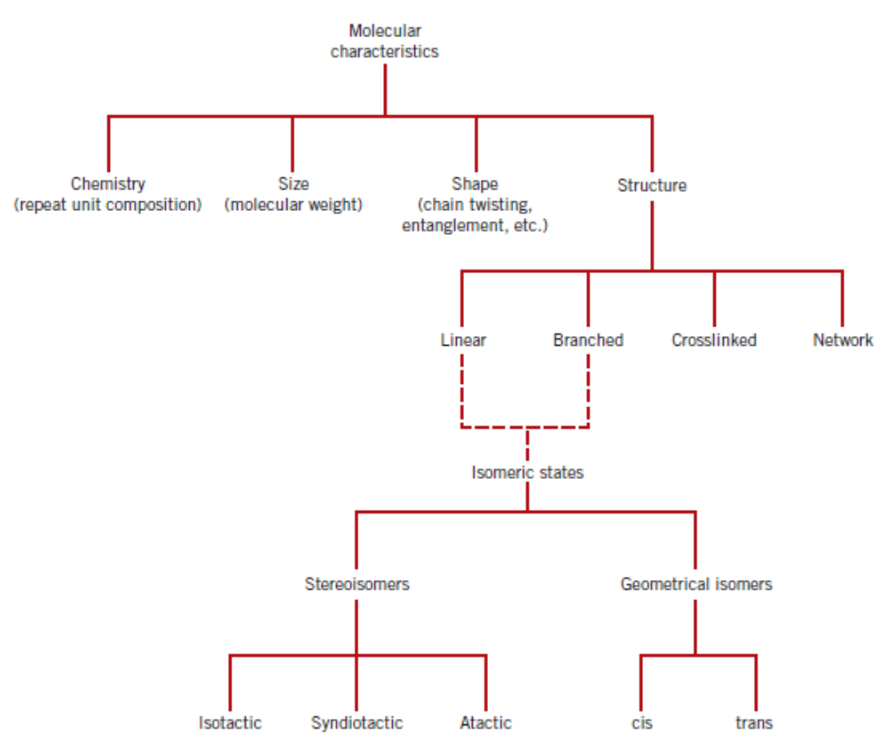
A Summary of Story So Far…

Slide 18
Thermoplastic and Thermosetting Polymers
Thermoplastic polymers are the ones that soften upon heating and harden upon cooling and these changes are reversible.
Polyethylene, Polystyrene, Polyethylene terephthalate, Polyvinyl Chloride are some of the examples of thermoplastic polymers.
Thermosetting polymers are the network polymers involving covalent cross–linking between adjacent chains. They harden upon formation and cannot be softened upon heating.
Examples: Vulcanized rubbers, epoxies and phenolics and some polyester resins.

Slide 19
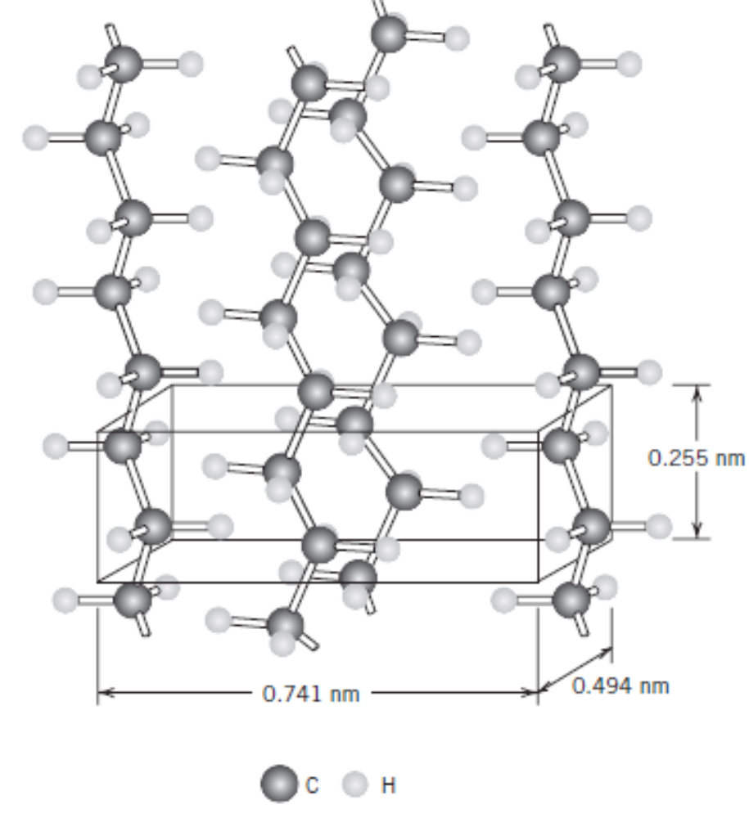
Polymer Crystallinity
Molecular substances of small molecules tend to form crystalline structures.
The density of crystalline polymers are more than the amorphous ones of same molecular weight.
Linear polymers tend to form crystalline structures upon controlled, slow cooling.
Within stereoisomers, atactic polymers (being random) cannot attain crystallinity. Syndiotactic and isotactic can form crystalline structures.
Block copolymers have a tendency to form crystalline structures.

Slide 20
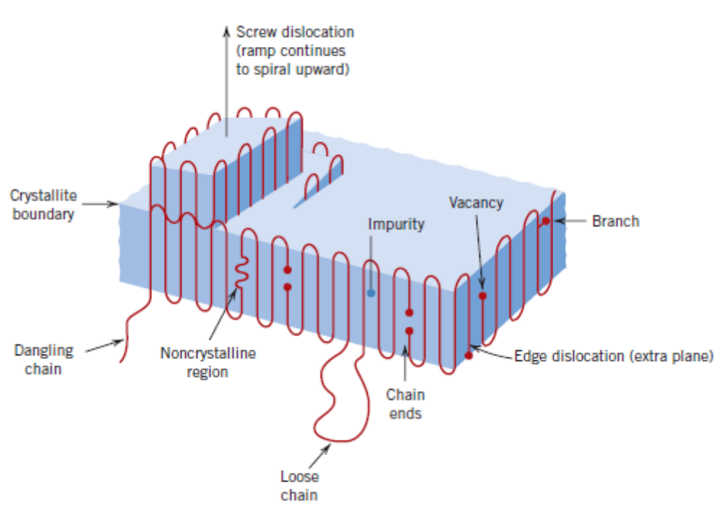
Defects in polymers

Slide 21
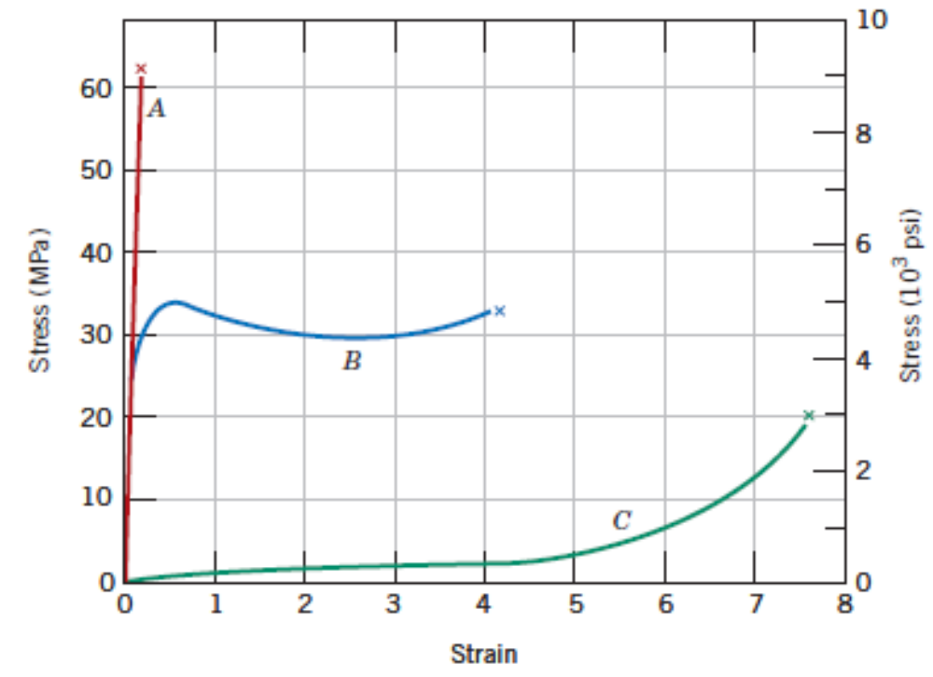
Mechanical Behaviour of Polymers
Curve A – Brittle
Curve B – Elastic-Plastic
Curve C – Highly Elastic (Elastomers)

Slide 22
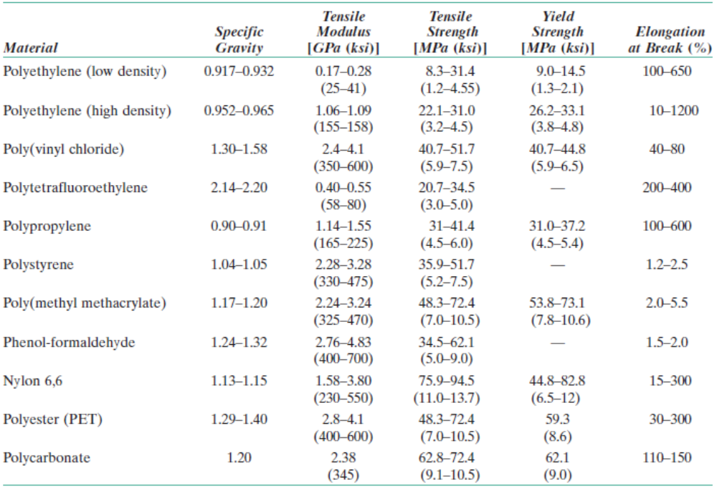
Mechanical Behaviour of Polymers

Slide 23
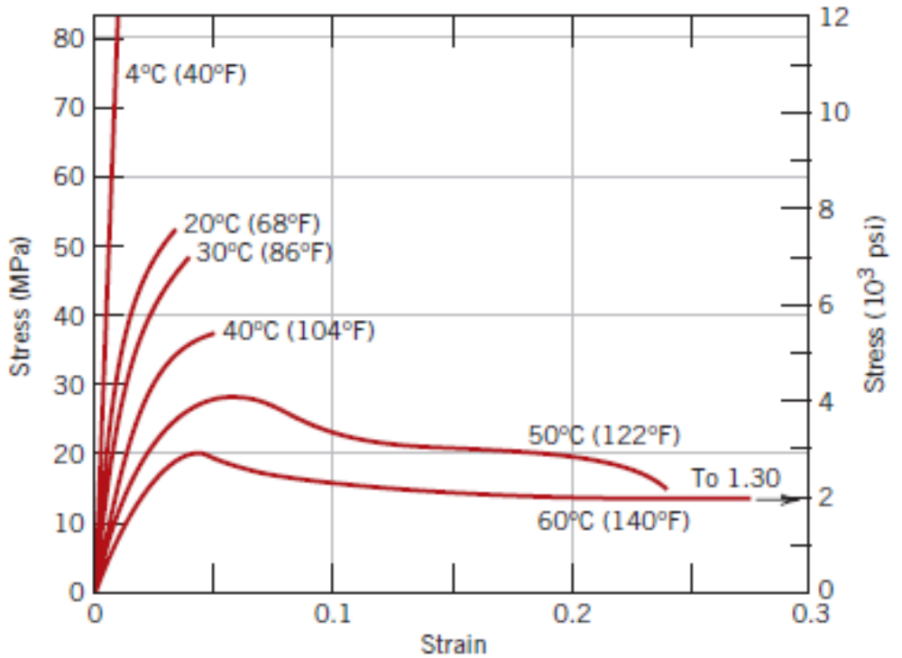
Mechanical Behaviour of Polymers – Influence of Temperature & Strain Rate
In addition to yield strength and ductility, Elastic modulus also changes (decreases with increase in temperature).
Stress – Strain curves shown in the adjacent figure are for PMMA.
T_{g} for PMMA is 105⁰C.
Decreasing the rate of strain applied has the same influence as increasing the temperature.

Slide 24
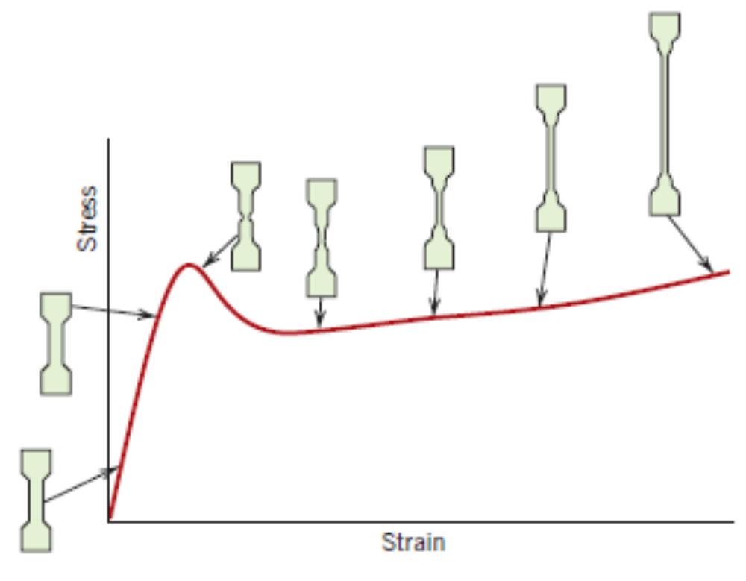
Macroscopic Deformation
Semi–crystalline polymers undergo very large strains and have stress–strain curves as shown in the figure below.

Slide 25
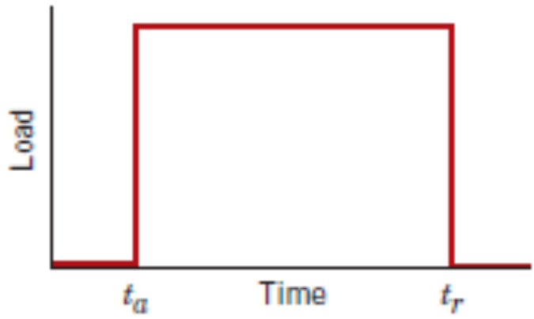
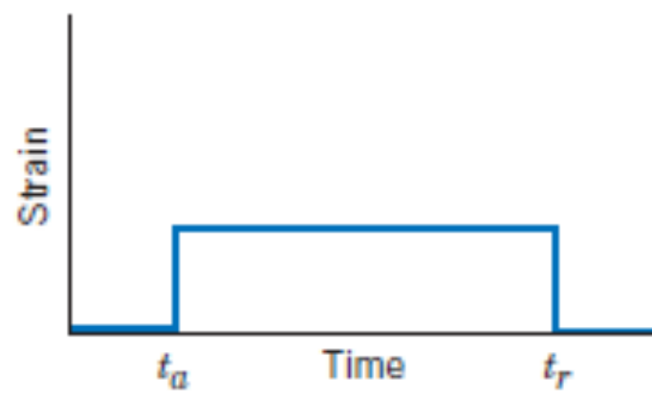
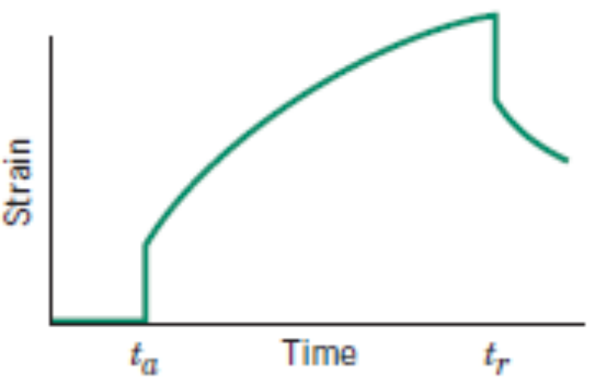
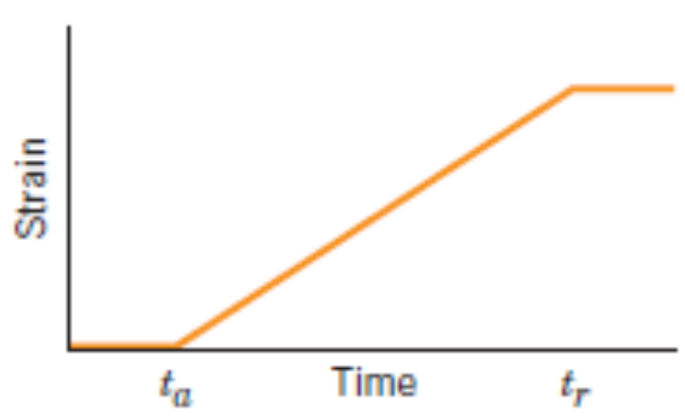
Viscoelastic Deformation
Applied loading history
The response Strain history for an elastic solid
The response Strain history for a viscoelastic solid
The response Strain history for a viscous medium

Slide 26
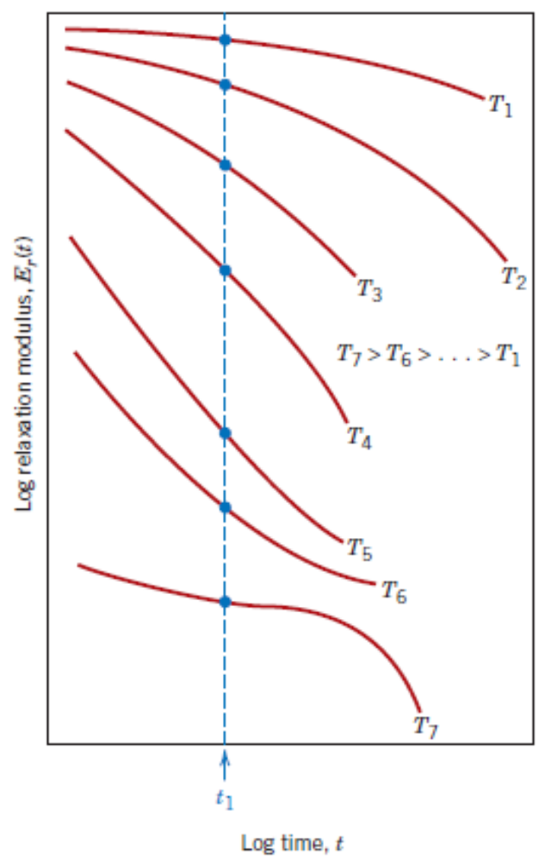
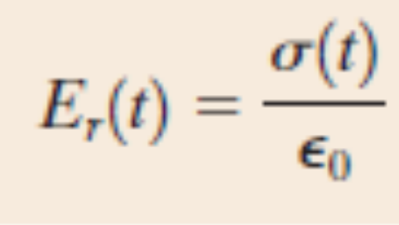
Viscoelastic Deformation
Viscoelastic behaviour of polymers is strongly dependent on both time and temperature.
Stress relaxation measurements where, an instantaneous, low strain is applied on the specimen, is normally used for testing viscoelastic polymers.

Slide 27
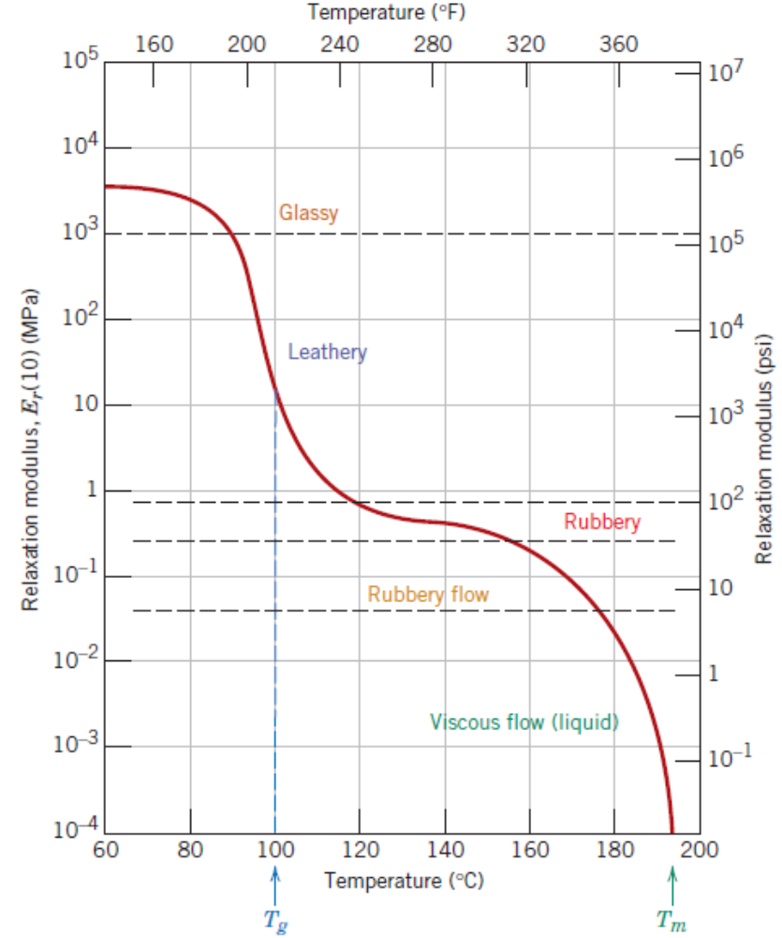
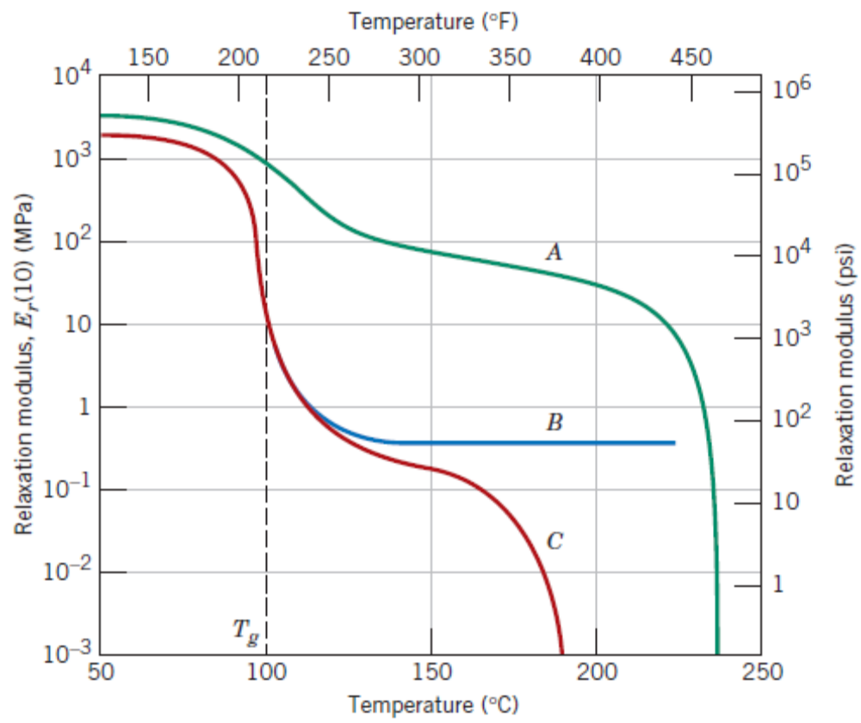
Viscoelastic Deformation
Relaxation modulus is a function of the temperature.
Relaxation modulus for (A) isotactic, (B) lightly cross–linked atactic and (C) amorphous polystyrene

Slide 28
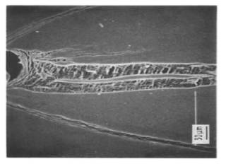
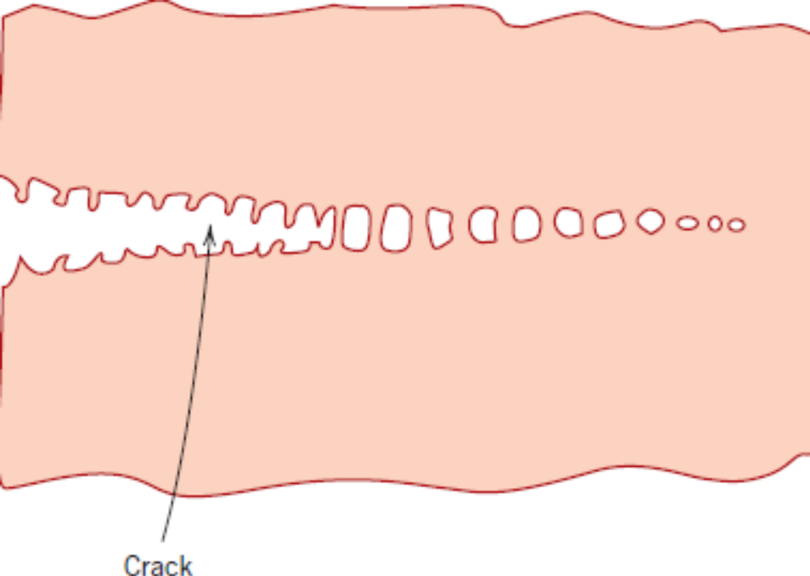
Fracture of Polymers
Thermosetting polymers fail in brittle manner. The covalent bonds of cross–linked structure or the network break.
Thermoplastic polymers may undergo either brittle or ductile modes of failure.
Phenomenon of Crazing
Fibrils
Microvoids

Slide 29
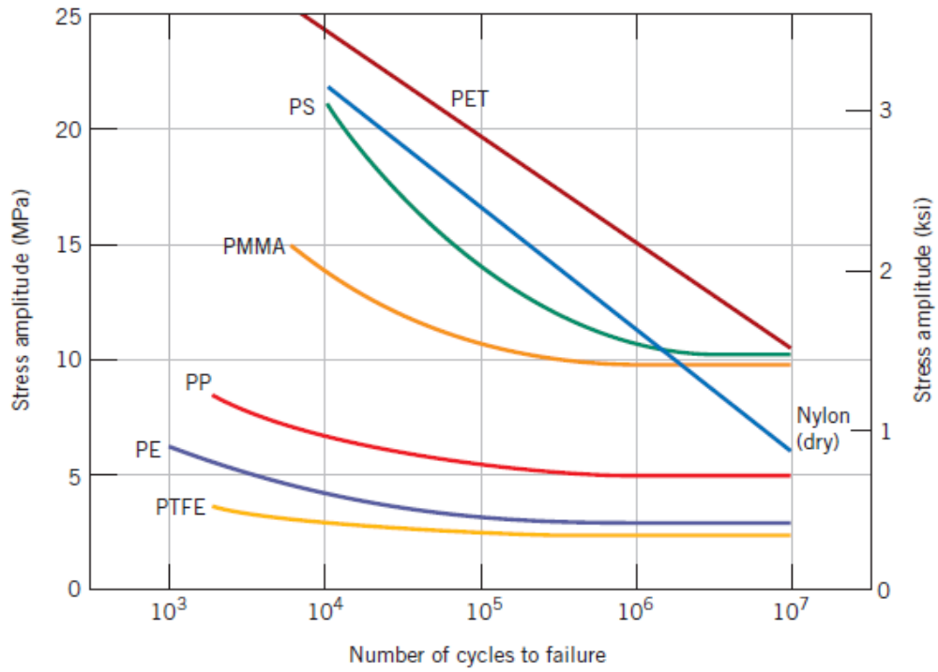
Fracture of Polymers
Impact Strength
Fatigue Strength
Tear Strength and Hardness

Slide 30
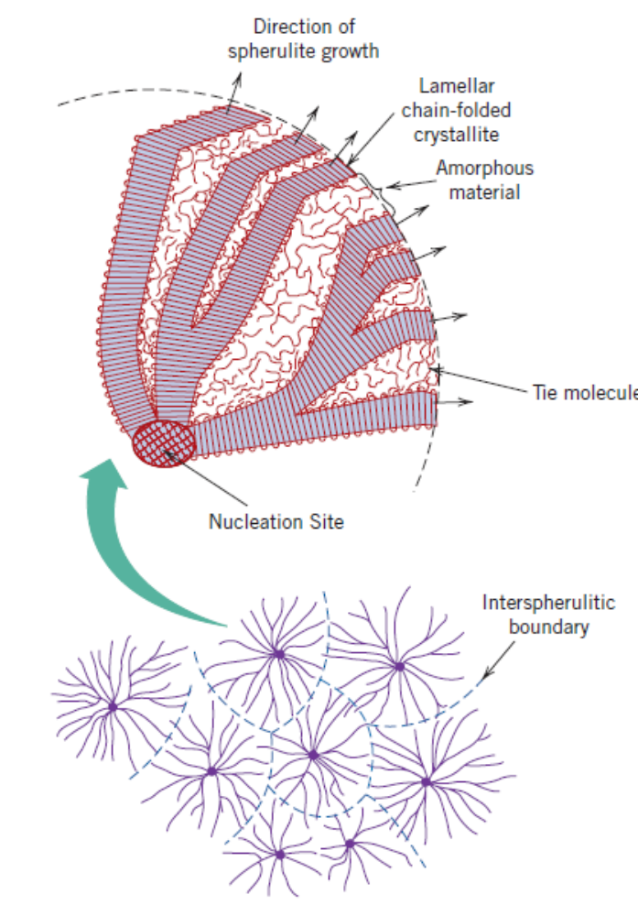
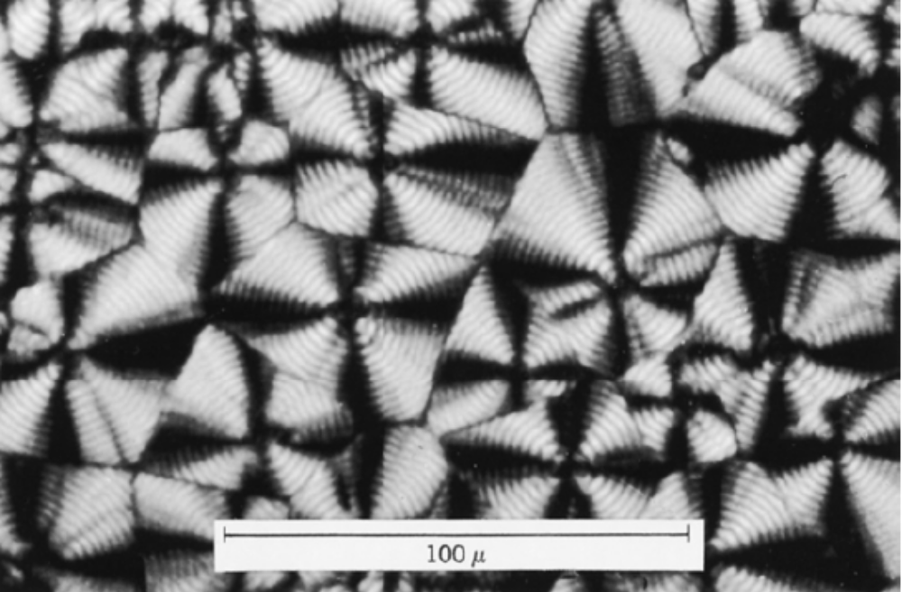
Mechanisms of Deformation and Strengthening of Polymers
Semi–crystalline polymers have spherulitic microstructure with crystallites embedded within amorphous zones.
Spherulitic microstructure of polyethylene

Slide 31
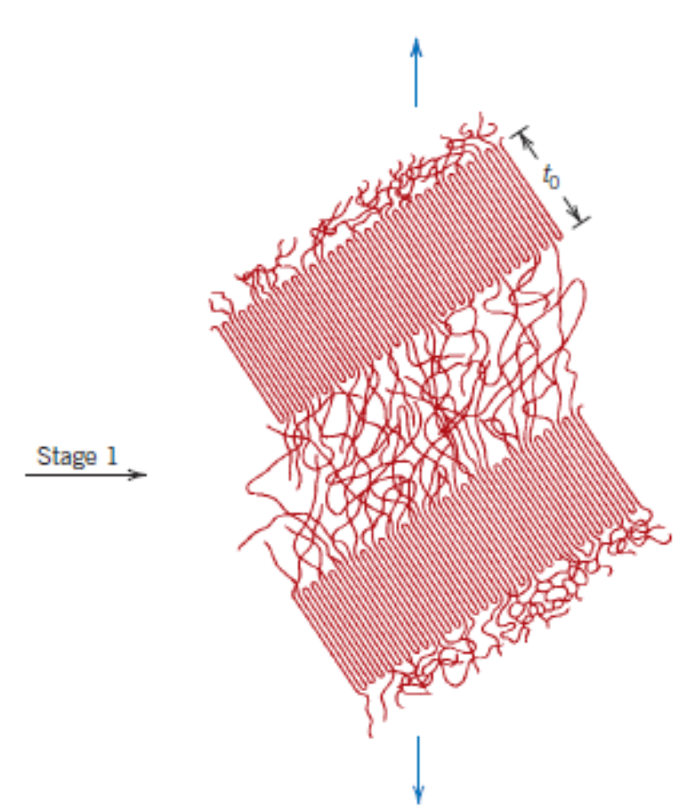
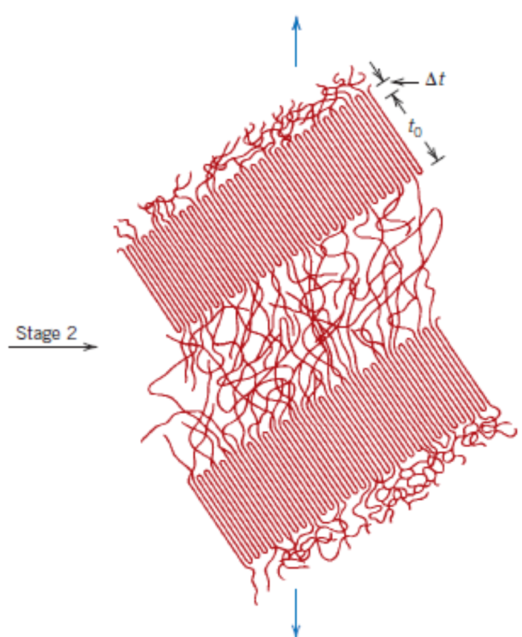
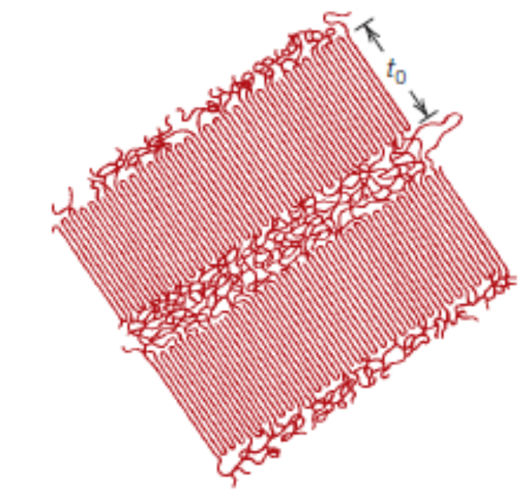
Deformation of Semicrystalline Polymers
Elastic deformation occurs in two stages – (1) amorphous (2) both amorphous and lamellae

Slide 32

Deformation of Semicrystalline Polymers
After the stage 2, plastic deformation begins. In stage 3, lamellae orients such that the chains of lamellae are aligned in the direction of the load.

Slide 33

Deformation of Semicrystalline Polymers
In stage 4, many chains in the lamellae region unwind.

Slide 34


Deformation of Semicrystalline Polymers
In stage 5, many chains in the lamellae region unwind significantly and orient along the direction of load.

Slide 35

Factors influencing the mechanical properties of semicrystalline polymers
Temperature
Strain rate
Molecular weight
Degree of crystallinity
Predeformation by drawing
Annealing – to increase yield strength, increase tensile modulus and reduce ductility

Slide 36


Deformation of Elastomers
The material must be above glass transition temperature

Slide 37


Deformation of Elastomers – Vulcanization

Slide 38

Crystallization, Melting and Glass Transition
Crystallization happens upon cooling.
Polypropylene

Slide 39

Crystallization, Melting and Glass Transition
Aromatic groups and double bonds increase melting temperature.
Bulky or large side group sizes increase melting temperature.
At low molecular weights, increasing number average molecular weight increases the melting temperature.
Branching may decrease the melting temperature.
Glass transition temperature also has similar dependence. In addition, T_{g} has stronger dependence on chain flexibility. Normally T_{g} lies between 0.5 – 0.8 T_{m}.

Slide 40
Various polymer types – Applications Perspective
Plastics
Elastomers
Fibers
Coatings
Adhesives
Films
Foams
UHMWPE – Ultra High Molecular Weight Polyethylene
Liquid Crystal Polymers
Thermoplastic Elastomers

Slide 41
Polymer Synthesis and Processing
Polymer additives
Fillers – Strength, hardness, abrasive resistance are improved. Typical fillers used are wood flour, sand particles, silica flour, glass, clay, carbon, talc, limestone.
Plasticizers – to soften and induce ductility. Generally low molecular weight liquids are added.
Stabilizers – to absorb UV light. UV light can degrade materials by causing breakage of existing bonds and further unwanted cross–linking.
Colorants – for imparting a specific colour
Flame Retardants – for fire fighting applications

Slide 42

Forming Techniques for Plastics
Compression molding

Slide 43

Forming Techniques for Plastics
Injection molding

Slide 44

Forming Techniques for Plastics
Extrusion

Slide 45

Forming Techniques for Plastics
Polymer Films

Slide 46


Forming Techniques for Plastics
Fibers by Spinning
Dry Spinning
Wet Spinning

